Slide 1
REVIEW OF “NUCLEAR FUEL MODELLING & PERSPECTIVES ON CANADIAN EFFORTS IN FUEL DEVELOPMENT”

Slide 2
INTRODUCTION
Ceramic fuels have been the central focus of Canadian research efforts over the past several decades
Article reports evolution and contemporary modeling methods employed in various fuel performance simulation branches, that is, the aggregate spanning from continuum scale to atomistic scale endeavors.
While not intended to replace experiments, previously acquired (experimental) data is used for modern day simulation input and augmentation.
Canadian fabricating sophistication, based on prior successful production of various fuels, is currently the foundation for developing advanced fuels. CNL researchers are working to design intricate manufacturing processes necessary.
Notes:
Since computer models allow nonessential experiments to be avoided, simulation is used wherever possible due to large cost and time as well as the human exposure and even possibility of human error (contamination) associated with experiment .
Examples of some manufacturing processes are spark plasma sintering
And
Additive manufacturing

Slide 3
LABORATORY EXPERIMENTS FABRICATION, IN-CORE UTILIZATION, & POST-IRRADIATION ASSAY

Slide 4
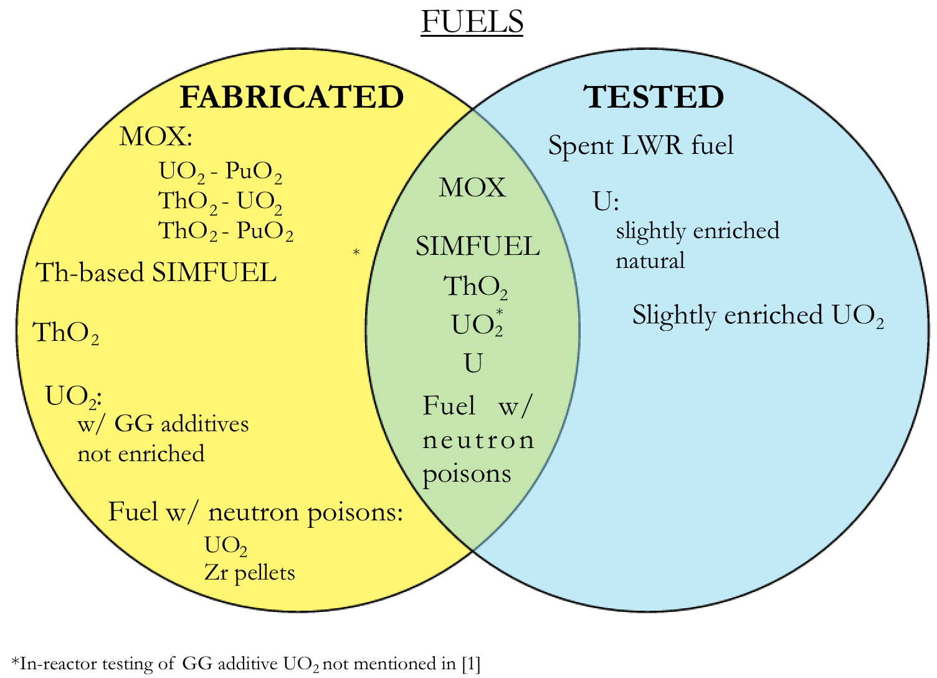
IN-REACTOR TESTING
Reactors (locations):
NRU (Chalk River, Ontario)
NRX (Chalk River, Ontario)
NPD (Rolphton, Ontario)
WR-1 (Whiteshell, Manitoba)
commercial PWHRs
Figure 2. Venn diagram of domestically fabricated and in-reactor tested fuels.
Notes:
The data used in for fuel performance simulation is based on data accumulated from studies carried out over the past 50 years.
The most influential attribute to Canadian nuclear fuel development is National Research Universal reactor or NRU. The NRU was shutdown on March 31st, 2018 and at this time was in fact the world’s oldest operating nuclear reactor. However, during its operation, the reactor played a HUGE role in the country’s nuclear fuel development. Basically, every fuel investigation or research that took place within the Canadian border was orchestrated by the NRU reactor.
Also located at Chalk River Labs, is the NRX or National Research Experimental reactor. This reactor was permanently shutdown in ‘93, but was the most intense neutron source in the world, what’s actually really interesting about this reactor is that it is heavy water moderated, but light water cooled (explain)
NPD = Nuclear Power Demonstration was the first Canadian nuclear power reactor, and prototype for the CANDU reactor design. It was a 22 MWe pressurized heavy water reactor and closed in 1987 upon exceeding operational goals.
WR-1, Whiteshell Reactor # 1, was a Canadian research reactor at White Shell National Laboratory (WSNL) It was built to test the concept of a CANDU-type reactor that replaced the heavy water coolant with an oil substance. Between 1971 and 1973 efforts to turn it into a full power reactor were terminated because heavy water-cooled units became the standard.
Slightly enriched – around 1% enrichment. looked into enriched Uranium because for a given Separative Work Unit,
“SWU for short” is essentially the dollars per kg Uranium ($/kg U) (usually people talk about a kg of SWU – I,e, dollars) increased enrichment demonstrated to have cheaper total fuel cycle cost, i.e. 0.9% enrichment results in a 30% reduction in total fuel cycle costs over the whole range of enrichment and natural-uranium prices.

Slide 5
COMPUTATIONAL EXPERIMENTS SIMULATION & MODELING

Slide 6
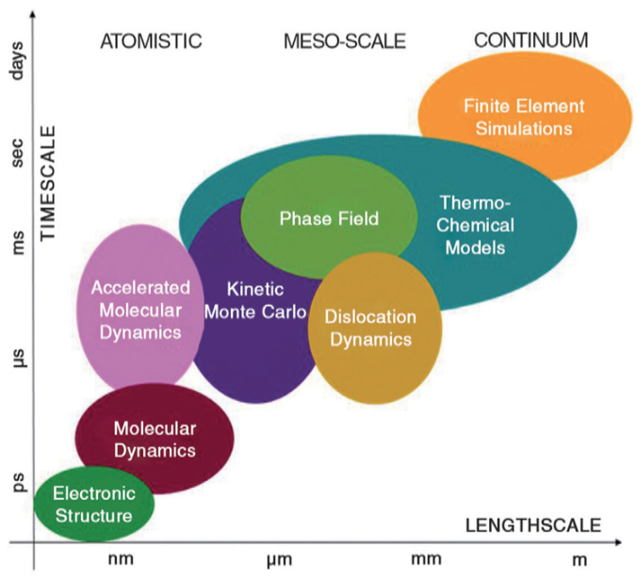
NUCLEAR FUEL SIMULATION
Continuum scale
Prospective fuel failure
Fuel performance
Thermodynamic
Phase equilibria
Chemical stability
Meso-scale
Irradiation-induced microstructure evolution
Atomistic scale
Thermal properties
Material parameters
Atom mechanisms
Figure 2. Time and length scale of phenomena simulated by various fuel modelling schemes [2]
Notes:
Meso-scale:
Microstructural evolution
and continuum methods are often “atomistically informed”,
in the sense that some of the parameters in the methods are optimized
against the output of atomistic calculations.

Slide 7
CONTINUUM SCALE
Simultaneously model:
Thermally induced strain
Densification
Cracking
Elastic/plastic deformation
Swelling
Traditional Codes:
ELESIM & ELESTRES for NOC
ELOCA for accidents
Contemporary efforts:
Assessing BISON for UO₂
MOX fuel models
Notes:
ELESIM and/or ELESTRES for normal operation
ELOCA for accident scenarios e f
inite element method is used for studying behavior of irradiated fuel (strain, cracking, temperature distribution, fuel-pellet interaction, etc.)
Developed between 1960 – 1990
Heavily validated in early 2000’s
Fuel swelling
Pellet Cladding Mechanical Interaction (PCMI)
Stress Corrosion Cracking (SCC)
Upon crack reaching fuel, FPs released into primary loop
Talk about BISON and coupling involved as well as input files and how it works (BUT NOT TOO MUCH!)

Slide 8
THERMODYNAMIC MODELING
Irradiated UO₂ & UO_{2+X}
Irradiation by-products not included in older models
Modern versions include FPs
Most comprehensive models include:
2 dozen elements
1 dozen liquid & SS phase models
Multitude of stoichiometric solid phases & gases
U-Mo/Mg
Candidate fuel for NRU
Chemical stability of U-Mo in Mg
Material properties used as input for heat transfer computations
Notes:
Used to compute and evaluate:
Phase equilibria
Chemical stability
Material properties
Thermodynamic modeling is highly _ for irradiatied UO2 and non-stoich. UO2 and U-Mo/Mg fuel
Irradiated UO₂ & UO_{2 + X}
Modeled with and without FPs & other activation products, more modern
Non-stoichiometric UO2 is UO2+X
UMo-UMg fuel consists of U-Mo fuel particles disseminated in Mg matrix
U-7Mo and U-10Mo _ were tested in NRU as it was U-Mo/Mg fuel was a candidate fuel for it. This nuclear fuel deems an attractive alternative to UO2 due to high degree of in-reactor reliability (more on this) & proliferation resistance (i.e. low enriched uranium).
Simulated mainly for material props for input for heat transfer calculations and to evaluate the chemical stability of U-Mo particles in the Mg matrix

Slide 9
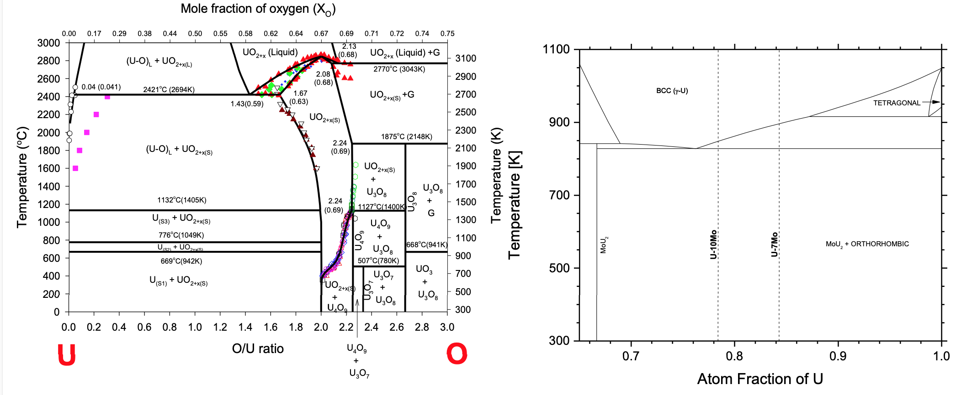
Figure 3a. U/O binary phase diagram
Figure 3b. U/Mo binary phase diagram

Slide 10
MESO-SCALE MODELS
Phase field model
Minimizes interfacial energy
Allows density variation
Reasonably computes changes in cavity pressure due to accumulation of vacancies or other bubbles
Over-pressurized bubbles induce localized stress field which attract vacancies via local stress field
Shell – porosity model
New model for bubble transformation under irradiation
Projecting 3-D behavior on 2D grain geometry yields smaller computational expense
Time evolution via system energy minimization
Conserves chemical species
Successfully verified against contact angle theory
Notes:
Simulates the microstructural evolution due to irradiation damage
Particular interest is _ to intra-granular Fission gas bubble migration, agglomeration, and coarsening in fuel matrix
Insoluble in the fuel matrix, Bubbles lead to void swelling which in turn degrades heat transfer properties, increases risk and eventually can lead to PCMI
Bubble Interfacial energy is determined from surface energy, hydrostatic stress (of the medium), and the bubble radius
(Thermodynamically self-consistent multicomponent) Phase Field Model
Validated against young-Laplace model
Reasonably computes changes in void pressure while accumulating vacancies and other migrating bubbles
Overpressurization occurs whenever a bubble’s equilibrium pressure is exceeded.
Being overpressurized, bubble looks to ease stress by
1. absorbing vacancies which reduces pressure according to ideal gas law by increasing volume
2. Migrating to grain boundary – this also increases the volume due to increased atom distances at the interface
Computational expense is decreased by projecting the 3-D bubble behaivor on a 2D de geometry

Slide 12
ATOMISTIC SCALE MODELING
Classical MD
Based on classical mechanics
Unable to evaluate charge transfer
Empirical interaction potential functions
EAM/MEAM
Difficult for accurate accountability of PDs and FPs
DFT & DFT+U
Quantum-mechanical electronic structure computations
Can improve MD potentials
More restrictive time & spatial domain than MD due to increased DOF
Hubbard method
Corrects DFT energy functional by considering influence of localized (f-shell) electrons
Results provides direct input for engineering models
Notes:
Hubbard correct dft method = DFT+U
slightly computationally more expensive than traditional DFT
PD = Point defect
FP = Fission Product

Slide 13

THE FUTURE

Slide 14
ADVANCED FUEL FABRICATION
Ongoing research is being performed to develop manufacturing processes for advanced fuels that increase:
1. proliferation resistance
2. safety & reliability
3. accident tolerance
4. in-reactor performance
5. energy efficiency & sustainability
Examples:
spark plasma sintering
additive manufacturing
Notes:
Sustainability – looking into using MOX fuels by including Th or recycled Pu in UO₂

Slide 15
REFERENCES
[1] Piro, M., Prudil, A., Welland, M.J., Richmond, W., Bergeron, A., Torres, E., Maxwell, C.I., Pencer, J., Harrison, N., & Floyd, M. (2018). Nuclear Fuel Modelling and Perspectives on Canadian Efforts in Fuel Development.
[2] Stan, M. (2009). Discovery and design of nuclear fuels. Materials Today, 12, 20-28.

